Slide 1
Access to all about kids website & iep direct
Presentation Created by
Jillian Pomeranz MS Ed., SBL, SDL
Melissa Vitarelli MS Ed., BCBA

Slide 2
How To Retrieve Report Formats

Slide 3
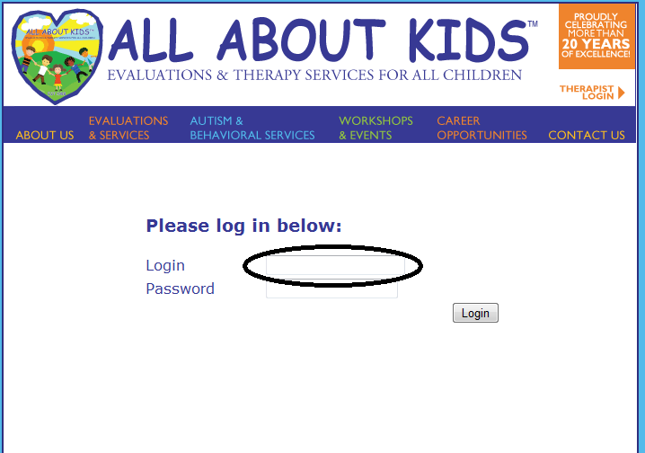
How To Retrieve Report Formats

Slide 4
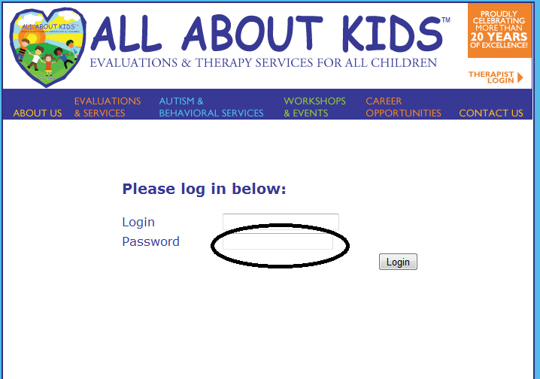
How To Retrieve Report Formats

Slide 6
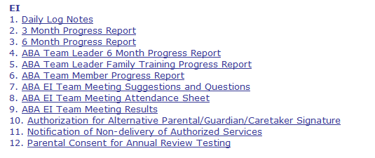

Slide 7
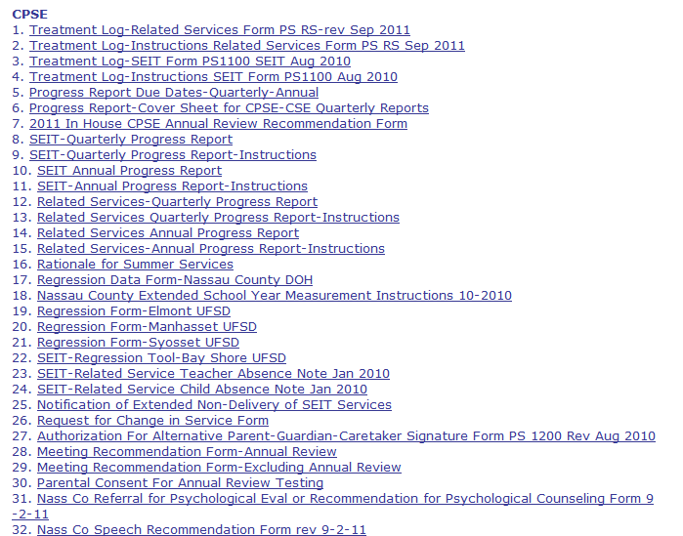

Slide 8
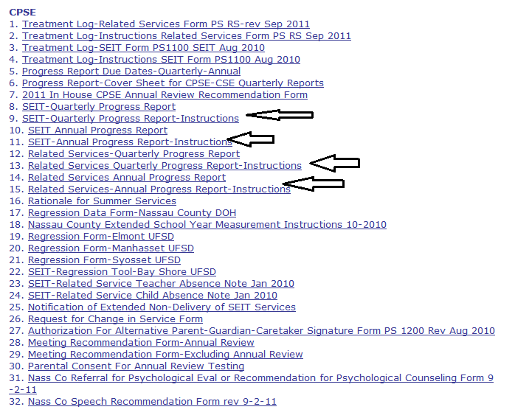

Slide 9
Accessing IEP Direct
www.iepdirect.com
Presentation Created by
Dr. David Ferrin
Director, Educational Services
All About Kids

Slide 10
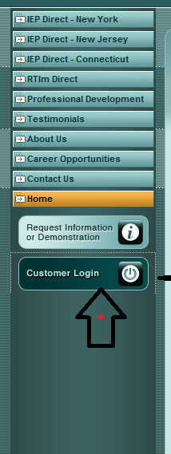

Slide 11
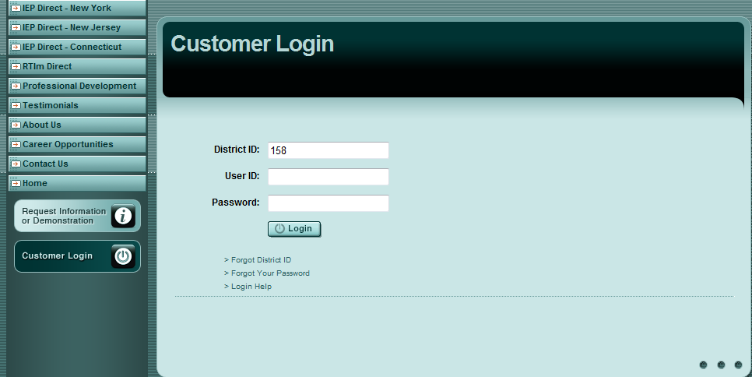
ALLABOUTkids4

Slide 14
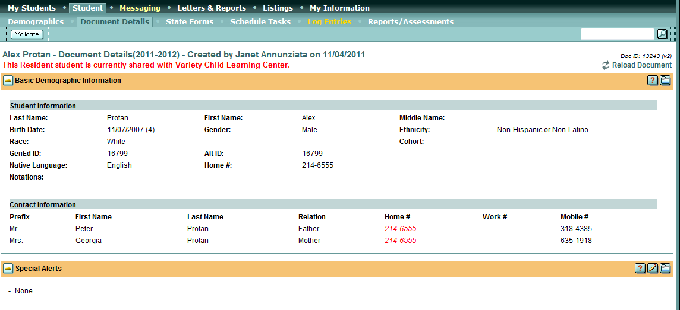

Slide 16
The Major Sections
SPAM Section
Evaluation/Reports Information
Standardized Test Results
Goals
Preschool Outcome Summary

Slide 17
SPAM

Slide 18
Entering SPAM S = Social P = Physical A = Academic M = Management

Slide 21
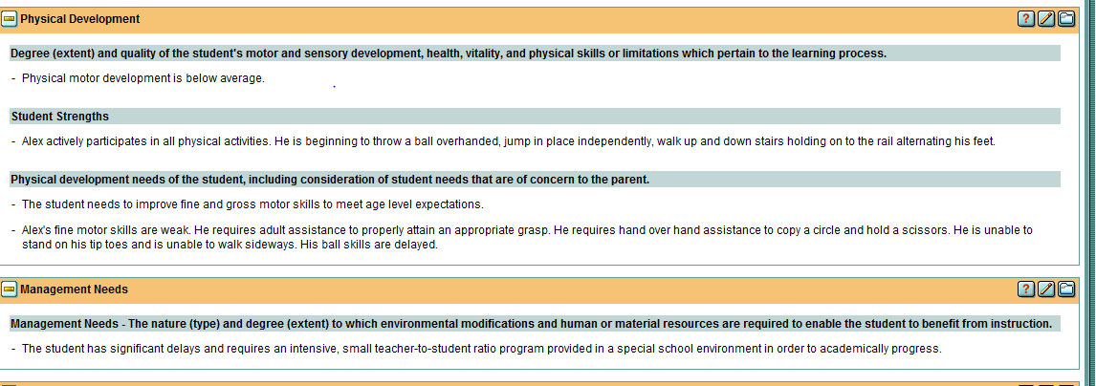

Slide 22
Evaluation/Reports Information

Slide 24
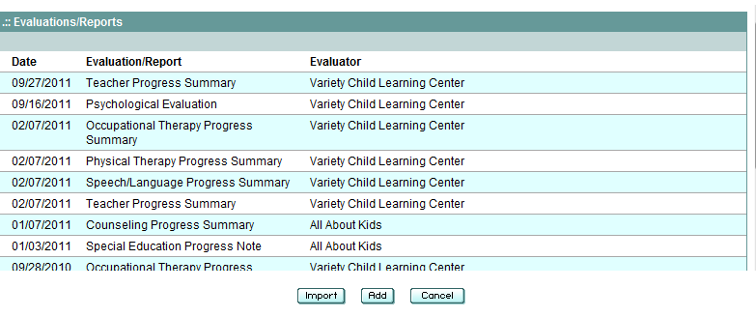

Slide 25
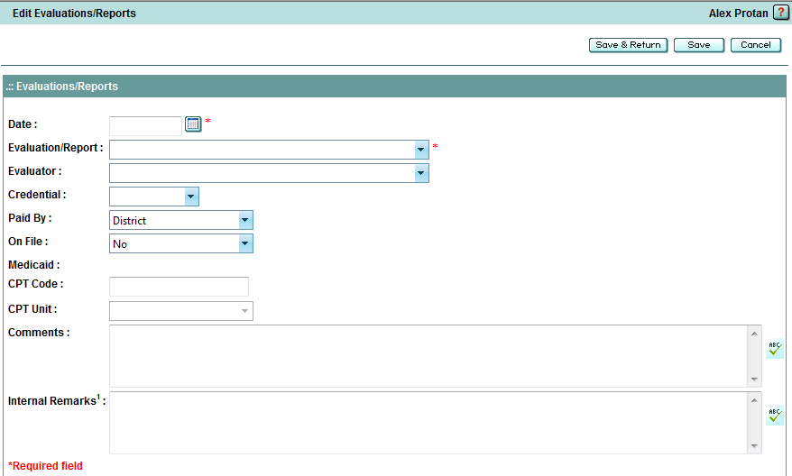
11/11/11
Educational Evaluation
All About Kids

Slide 26
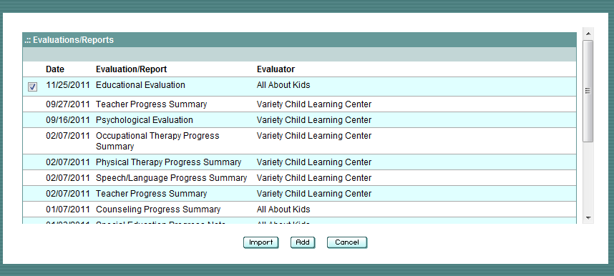

Slide 27
Standardized Test Results

Slide 29
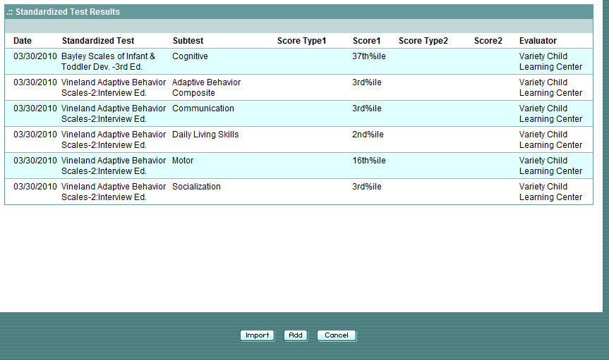

Slide 30
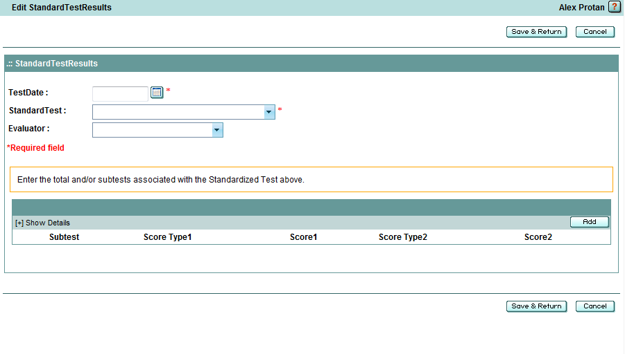
11/17/11
Preschool Language Scale-5
All About Kids

Slide 31
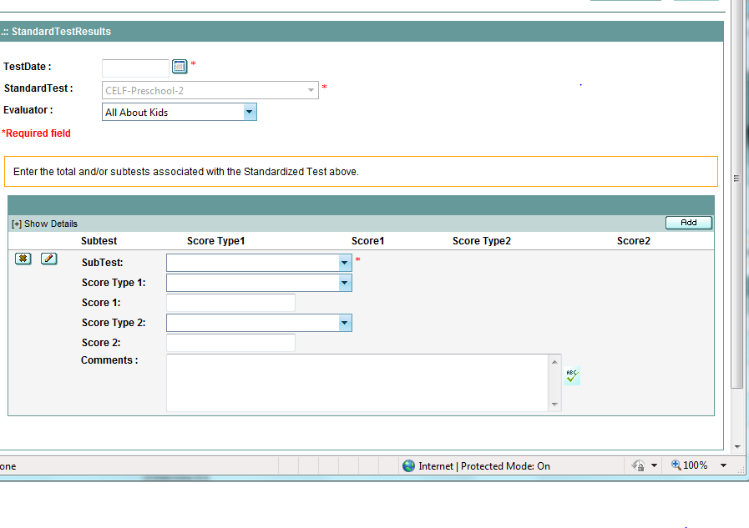
11/17/11
Preschool Language Scale - 5
Complete all appropriate fields for
every subtest.

Slide 32
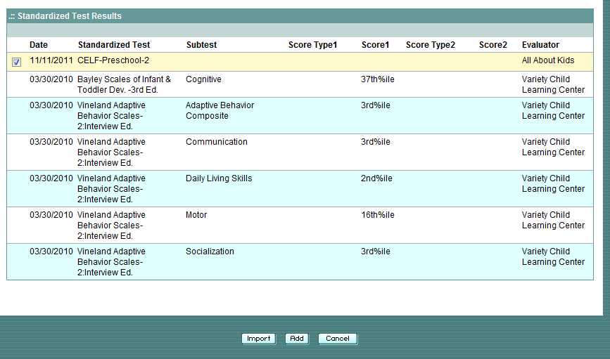
11/17/11 Preschool Language Scale - 5

Slide 33
Preschool Outcome Summary
For EVERY child transitioning to kindergarten.
For EVERY child being declassified.

Slide 34
Preschool Outcome Summary

Slide 35
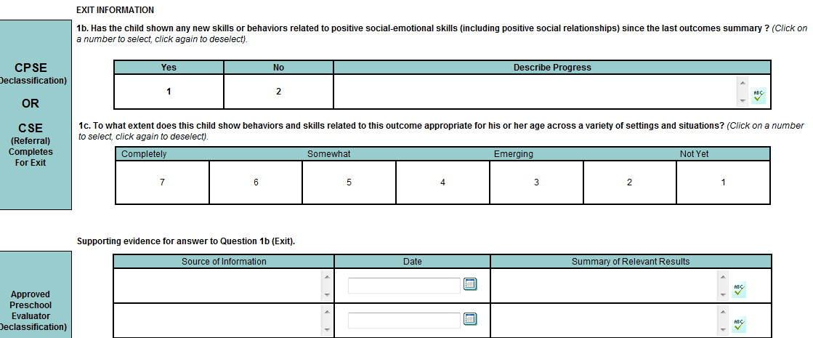
Positive Social-Emotional Skills

Slide 36
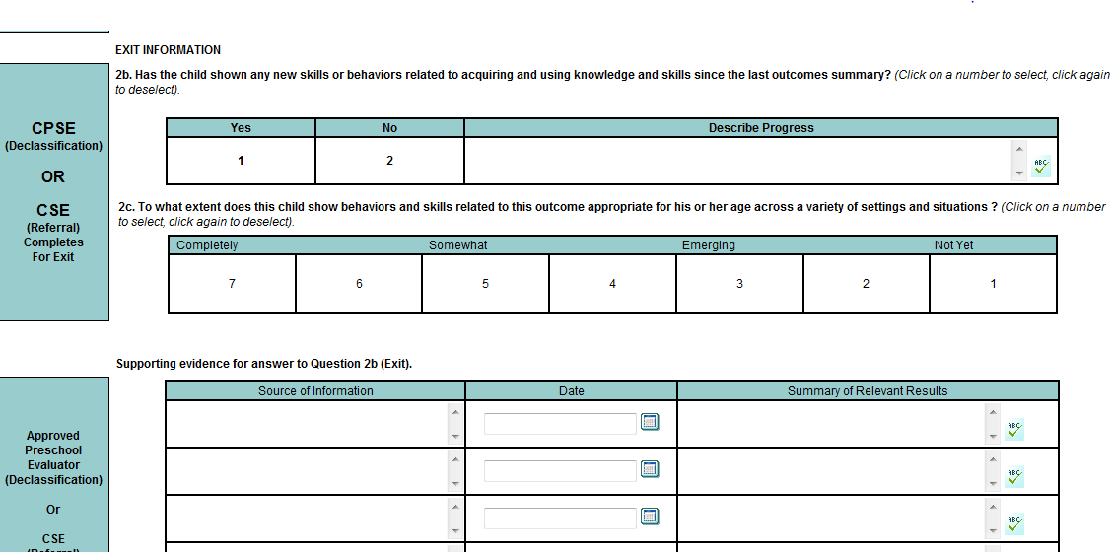

Slide 37
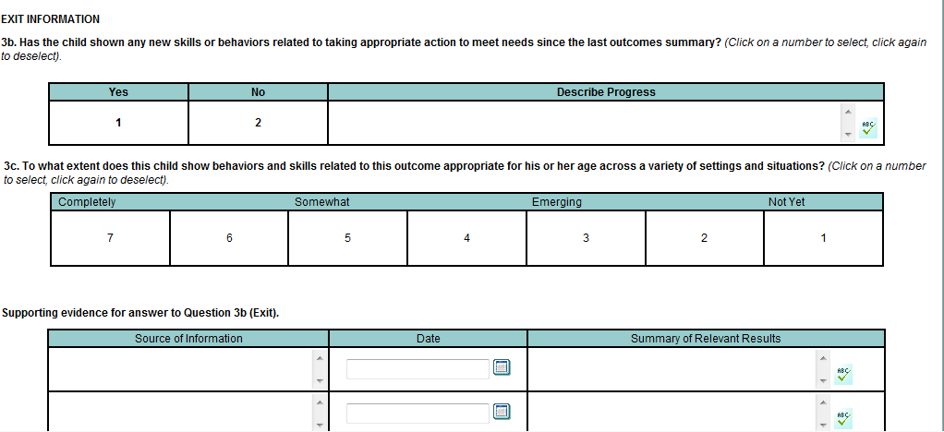

Slide 38
Measurable Annual Goals

Slide 39
Save, Add More Goals

Slide 40
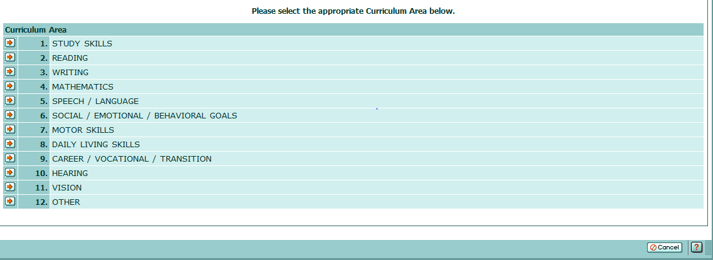
Click on Desired Domain

Slide 41
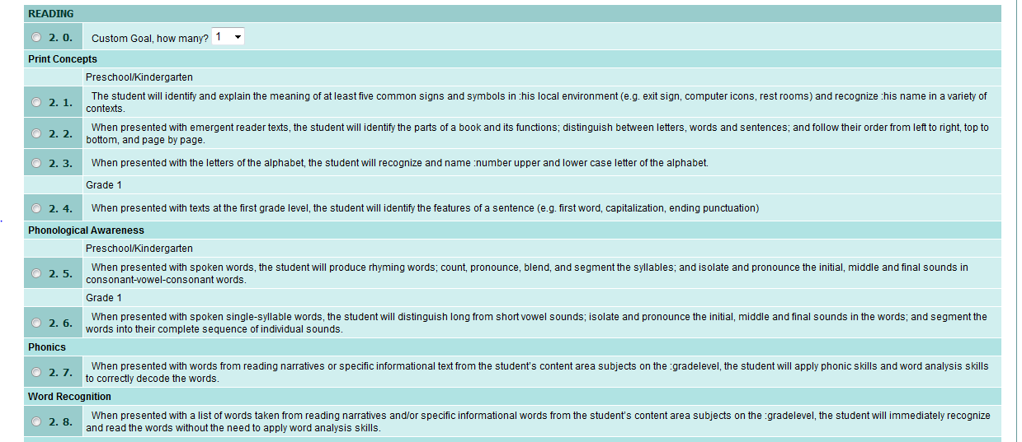

Slide 42
Choose the goal(s), then click on “continue”

Slide 43
Please select the appropriate Objective(s) below.
Click “continue”

Slide 44
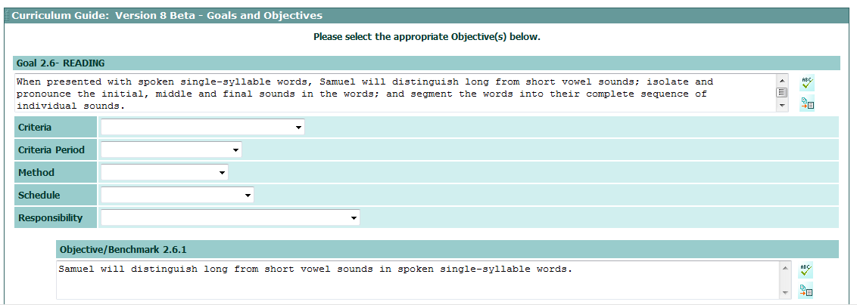

Slide 45
Criteria:
90% success
85% success
80% success
75% success
70% success 65% success 60% success 40% success 30% success
9 out of 10 trials
8 out of 10 trials
7 out of 10 trials
6 out of 10 trials
5 out of 10 trials
4 out of 10 trials
Criteria Period:
over 2 weeks
over 4 weeks
over 8 weeks
over 10 weeks
over 4 months
over 6 months
over 10 months
for 4 consecutive days
for 5 consecutive days
Method
Recorded observations
Classroom tests
Portfolio materials
Observation checklists
Behavior chartings
Structured interviews
Work samples
Self-monitoring checklists
Writing samples
Attendance records
Discipline records
Class participation
Homework assignments

Slide 46
Schedule
Quarterly
Daily
Weekly
Monthly
Quarterly
Every 2 weeks
Every 3 weeks
Every 4 weeks
Every 5 weeks
Every 6 weeks
Every 7 weeks
Every 8 weeks
Every 9 weeks
Every 10 weeks
Every marking period
By the end of every marking period
Every report card
Responsibility

Slide 47
To continue to add more goals, click on : “Save add more goals”
To save goals and move forward, click on: “Save”.

